Slide 1
Programming is a Team Sport
Building high quality, robust software requires a team

Slide 2
Survey of Audience
Please identify your experience as a professional software developer
Novice
Expert

Slide 3
Survey of Audience
Please identify your experience with Pair Programming
Novice
Expert

Slide 4
Survey of Audience
Please identify how you learn the best
Self Learning
Mentoring

Slide 5







My Background
Investing
Manufacturing
Banking
Notes:
Started as a developer in 1978 in the banking industry
Built telephone banking systems, ATM system, Check processing system
Program manager leading several teams to build an industry leading configuration system utilizing Artificial Intelligence to price, design and manufacture electrical distribution products.
CTO for a start up to automate investment management processes
Now an Agile coach and project manager leading development teams building software for Summa clients

Slide 6
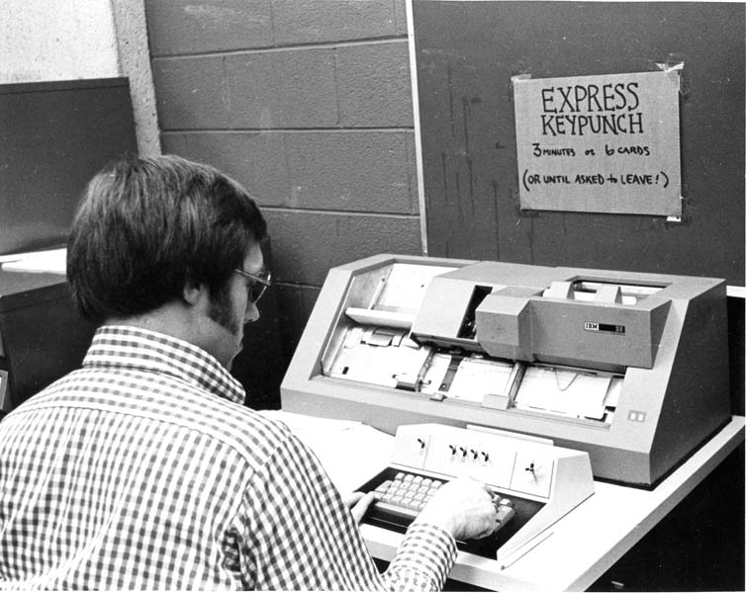
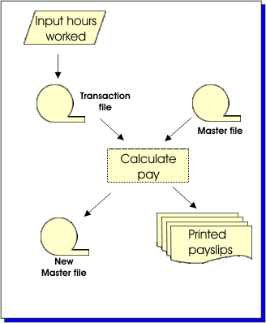
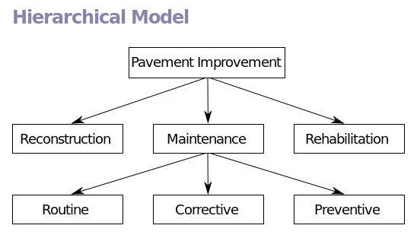
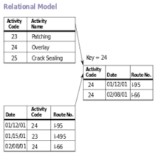
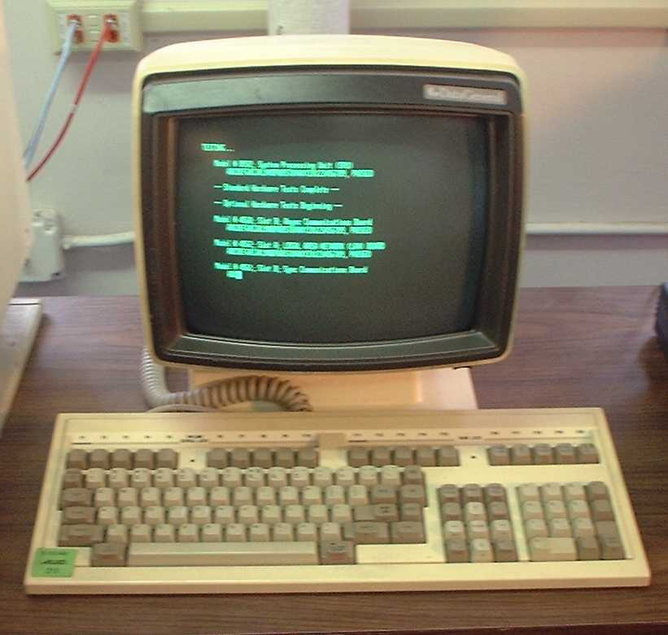
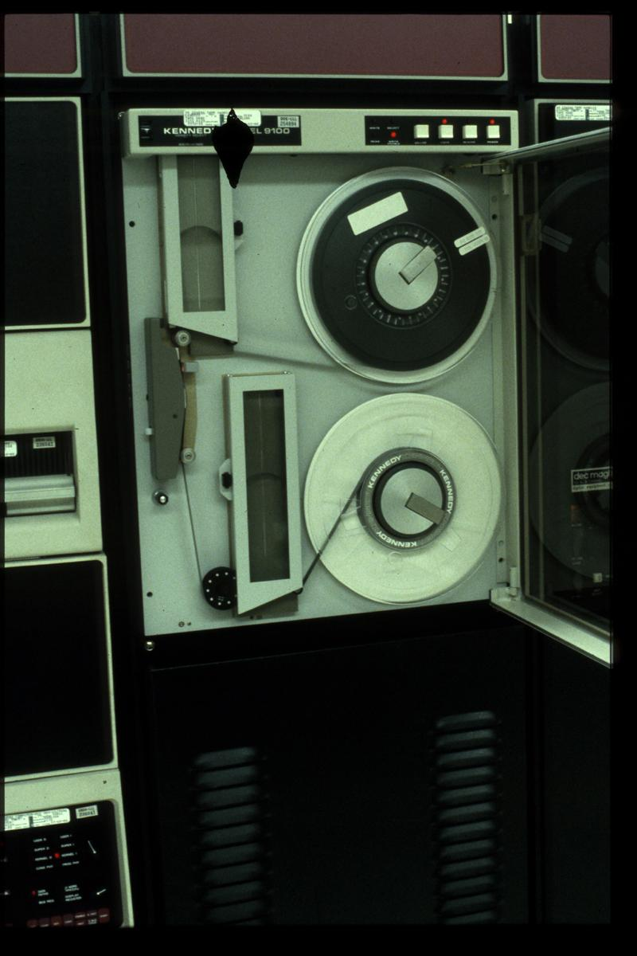
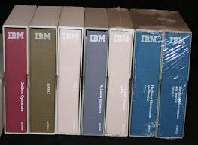
How I learned to program
Notes:
My college education consisted of two Cobol classes and a Fortran class working on computer cards. I remember well the lines at the card punch waiting to get my program punched out. You have no idea what a relief it was to work on a CRT terminal at my first job. Unfortunately it was still 80 character card format.
Came out of College in 1978 as a math major and got into a training program where we actually paired for our assignments. We would sit side by side around one terminal and write the code.
My first major project was converting the banks check processing system. No databases back then, you read in two tapes, the old master and the transaction file and then wrote out the new master. I was with a team of 5. Each of us had our assignments. I remember our team lead looking over my shoulder a couple times but mostly I had to read manuals to find answers to my questions.
In a few years I was working with hierarchical IMS databases and developing the telephone banking and ATM systems. This time I got to go to a week long class. I came back now the expert. Again, manuals were all we had. Our only conversation was understanding the requirements. I would design the database and provide that information to the other programmers.
Within a very few years I was working with the very early relational databases writing systems. Still working from manuals and going to classes. Every platform had its own operating system, db system and programming tools. No internet. Developer communities were just getting started.
A few years later I was building client server apps running on the first IBM Notebook PCs. They weighed 20 lbs. Very early days of the internet.
When Visual Basic came out I thought I had died and gone to heaven. In-line debugging, WYSIWYG forms builders. Systems were now becoming very complex. The goal of the average developer in that day was to get into the Zone.

Slide 7

The programming zone
The Programming Zone
Notes:
We considered it to be a great day if we spent the whole day engrossed in our code without any interruptions. Solving massive algorithms. We were one with our code. The Matrix is what we lived. We prided ourselves in being able to make our code do anything we could imagine.
So, what’s wrong with this picture?

Slide 8
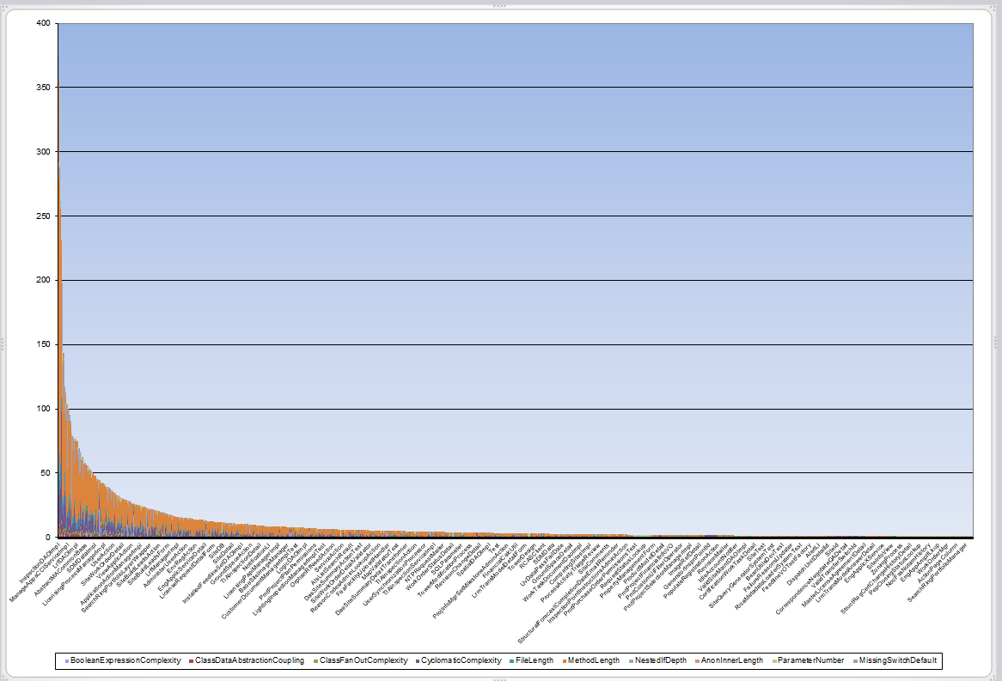
Toxic Code
Un-Readable
Un-Decipherable
Un-Maintainable
Notes:
A score > 1 is considered toxic
Cyclomatic complexity > 10
Module lines of code > 100
File lines of code > 1000
Highest toxicity score for a single program file was 376.1
18 scored higher than 100
326 scored 10 or more
1600 scored 1 or more
So many levels of inheritance no one can tell what the code is doing
No architectural consistency or patterns
Lets look at another factor that makes this individual approach to programming no longer viable.

Slide 9

Complexity is growing exponentially
Main frame development
1 Operating system
1 Language
1 UI device
1 Developer IDE
1 Database
Handful of third party add-ons
Chart from http://www.qsm.com/blog/2011/determining-market-share-popular-programming-languages?page=2 Kate Armel

Slide 10



Complexity is growing exponentially
Today
Operating Systems (Unix, Windows, iOS, Android, …)
UI languages (HTML Java Script, Angular JS, etc.)
Primary languages (Java, C#, Python, Ruby, VB, Cobol)
Hundreds of devices, 5 major browsers
Database skills (SQL, Hybernate, Mongo DB)
Application Servers (JBoss, Tomcat, WebLogic, WAS)
Configuration Management (Git, SVN, Ant, Maven, Jenkins)
Testing frameworks (Mocking, web services)
Integration tools (XML, SOAP)
Many IDEs
Thousands of third party developer tools (1,832 Eclipse plugins on Eclipse Marketplace marketplace.eclipse.org)
Capers Jones was commissioned to study software employment in major corporations and government groups, found 116 specialists
Chart from http://www.qsm.com/blog/2011/determining-market-share-popular-programming-languages?page=2 Kate Armel
Notes:
A single project will often have to deal with multiples of each of these. No one individual can possibly be an expert in all the technologies that are required today to build a single solution.

Slide 11
Early attempts at solving the maintainability problem
Meaningful variable names
C = A + B ➔
New_Acct_Balance = Old_Acct_Balance + Transaction_Amount
Coding standards were developed for projects
Naming conventions
Comments
Format
Inspection Points
Notes:
Inspection points was developed specifically for waterfall projects. The goal was to identify design and code defects as early in the process to reduce the costs of these defects.
Reality is that people hate doing inspection point analyses. There is more value in rapid feedback and very short development cycles.

Slide 12
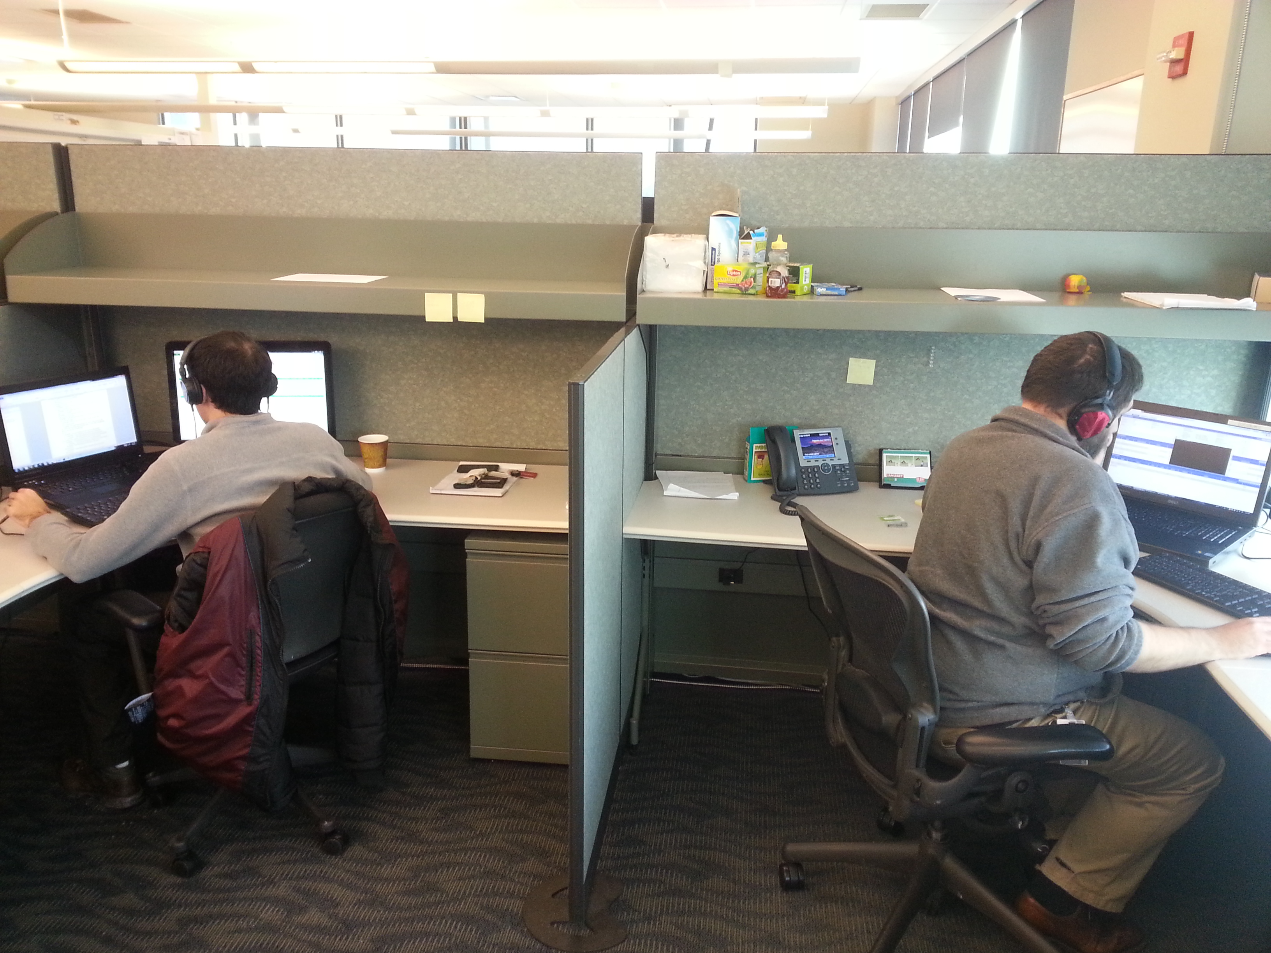
More modern approaches
Architectural patterns added to Standards
Database layer
Business Layer
UI Layer
UI Design Guides
Manual Code Reviews
Automated Code Reviewing Tools
Unit Test Frameworks and TDD
Notes:
All of these things are good and I endorse them vigorously, but programmers are people and our nature is to fall back on old habits and to do our own thing.
How many code reviews degenerate into style debates, are they not often dull and boring affairs that most would avoid like the plague if they could.
Complex solutions can still be very difficult to decipher. Over engineering is still a serious malady.

Slide 13
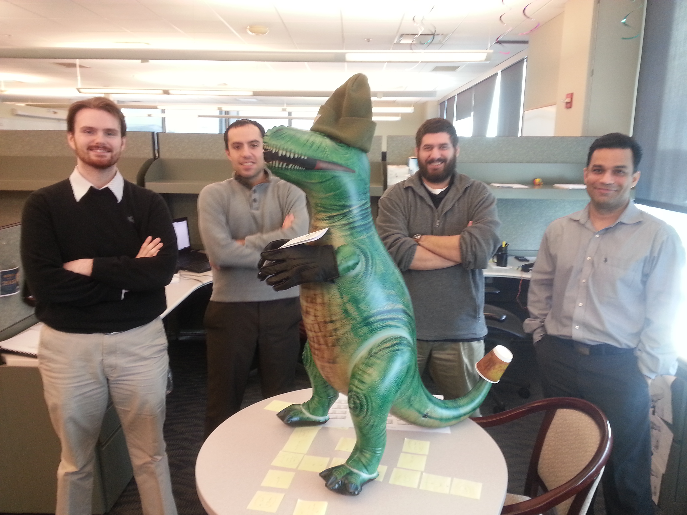
Programming needs to be a team sport to handle the modern programming challenges
Notes:
This is my team right now. This is our mascot TT. All teams should have a mascot. It’s a great way to build team moral and keep the work from becoming drudgery.

Slide 14
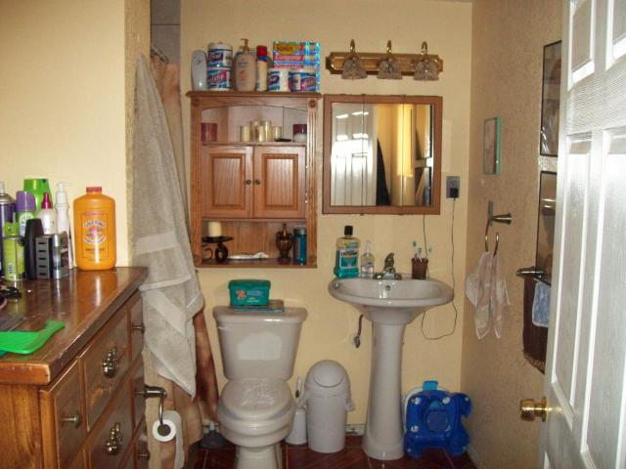


Team Ownership
Drivers
Lottery Effect
Cleaner Code
Better design

Slide 15



Though one may be overpowered, two can defend themselves. A cord of three strands is not quickly broken.
Solution 1n
Solution 2
Solution 4
Solution 3
Solution 5
Notes:
This is a Biblical proverb but it applies perfectly to this idea of programming is a team sport.
What we need to understand is that programming, even a simple enhancement is a creative activity.
One has to solve a complex algorithm
Identify all of the impacted modules
Trace all of the existing logic to make sure we don’t inject unexpected behavior
Understand the underlying data model, etc.
I think we all recognize that creative processes are more effective when done in a collaborative way.
We have no issue designing the UI collaboratively.
We have no issue problem solving collaboratively trying to find the root cause of an issue.
When programming isn’t being creative it is heavy problem solving.

Slide 16
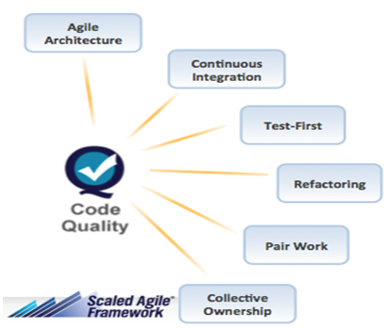
Techniques for driving more team ownership
Code reviews
Carpaccio slicing of stories
Incremental team design sessions
Swarming stories
Pair programing
Notes:
So, we are going to take a look at some straight forward effective ways to make the art of programming a team sport.
We will take a short dive into each of these for the rest of this session. We are a partner with the Scaled Agile Framework and you will find these same techniques covered in the framework under code quality.
The primary point Dean makes is that you can’t scape crappy code. This is absolutely true. The beauty of these techniques is you can adapt them whether you are agile or not. These will work inside of Scrum, Kanban, Waterfall or any program level methodology. In fact, this is where I advise my clients to begin when adapting Agile. Master the 6 code quality aspects of the Scaled Agile Framework will prepare you well for adapting the rest of the framework.

Slide 17
Code Review tips
Potential to be a storming activity
Develop a code of conduct agreement
Focus on design patterns and unit testing
Avoid style wars
Time box to one hour a week
Don’t review straight forward code
Notes:
If you are familiar with Tuckman’s stages of group development, this can take a team from performing back to storming if not done carefully.
Even if you adopt Pair Programming there is still a place for code reviews. These will extend knowledge beyond the pairs and helps new developers get up speed more quickly.

Slide 18

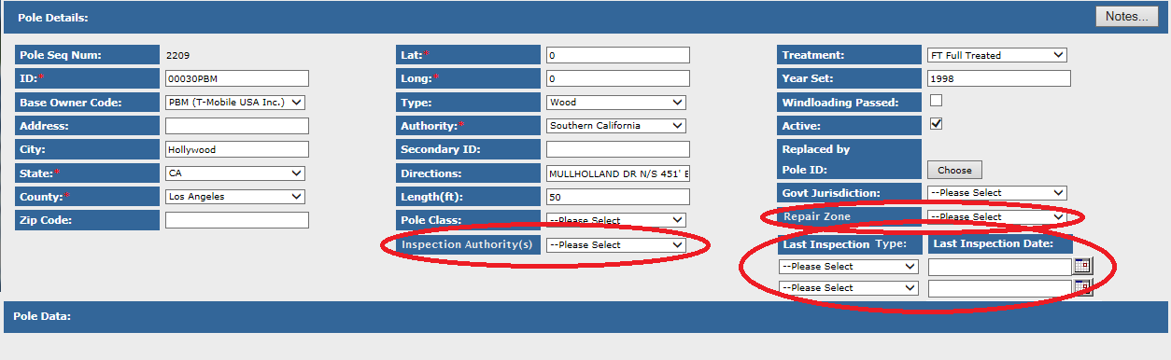
Carpaccio Story Slicing
Slice your stories as thin as possible
Divide the work across multiple developers
Notes:
Each story must still add value. Each story must be vertically sliced. (Independent) Let me give you an example
Here are three fields that need to be added to this page.
Typical approach would be to make this one story since it will all touch the same code. Your QA analysts will also push for this so they only have to test this page once.
But, visiting the code multiple times will cause refactoring that will make it more robust even if only one developers does all of the stories.
Obviously spreading the work is the ideal. It is also good for the QA to touch this page multiple times. Each time they will be testing different things but they will also end up regression testing increasing the likelyhood that they will uncover a bug they would not have uncovered otherwise.

Slide 19
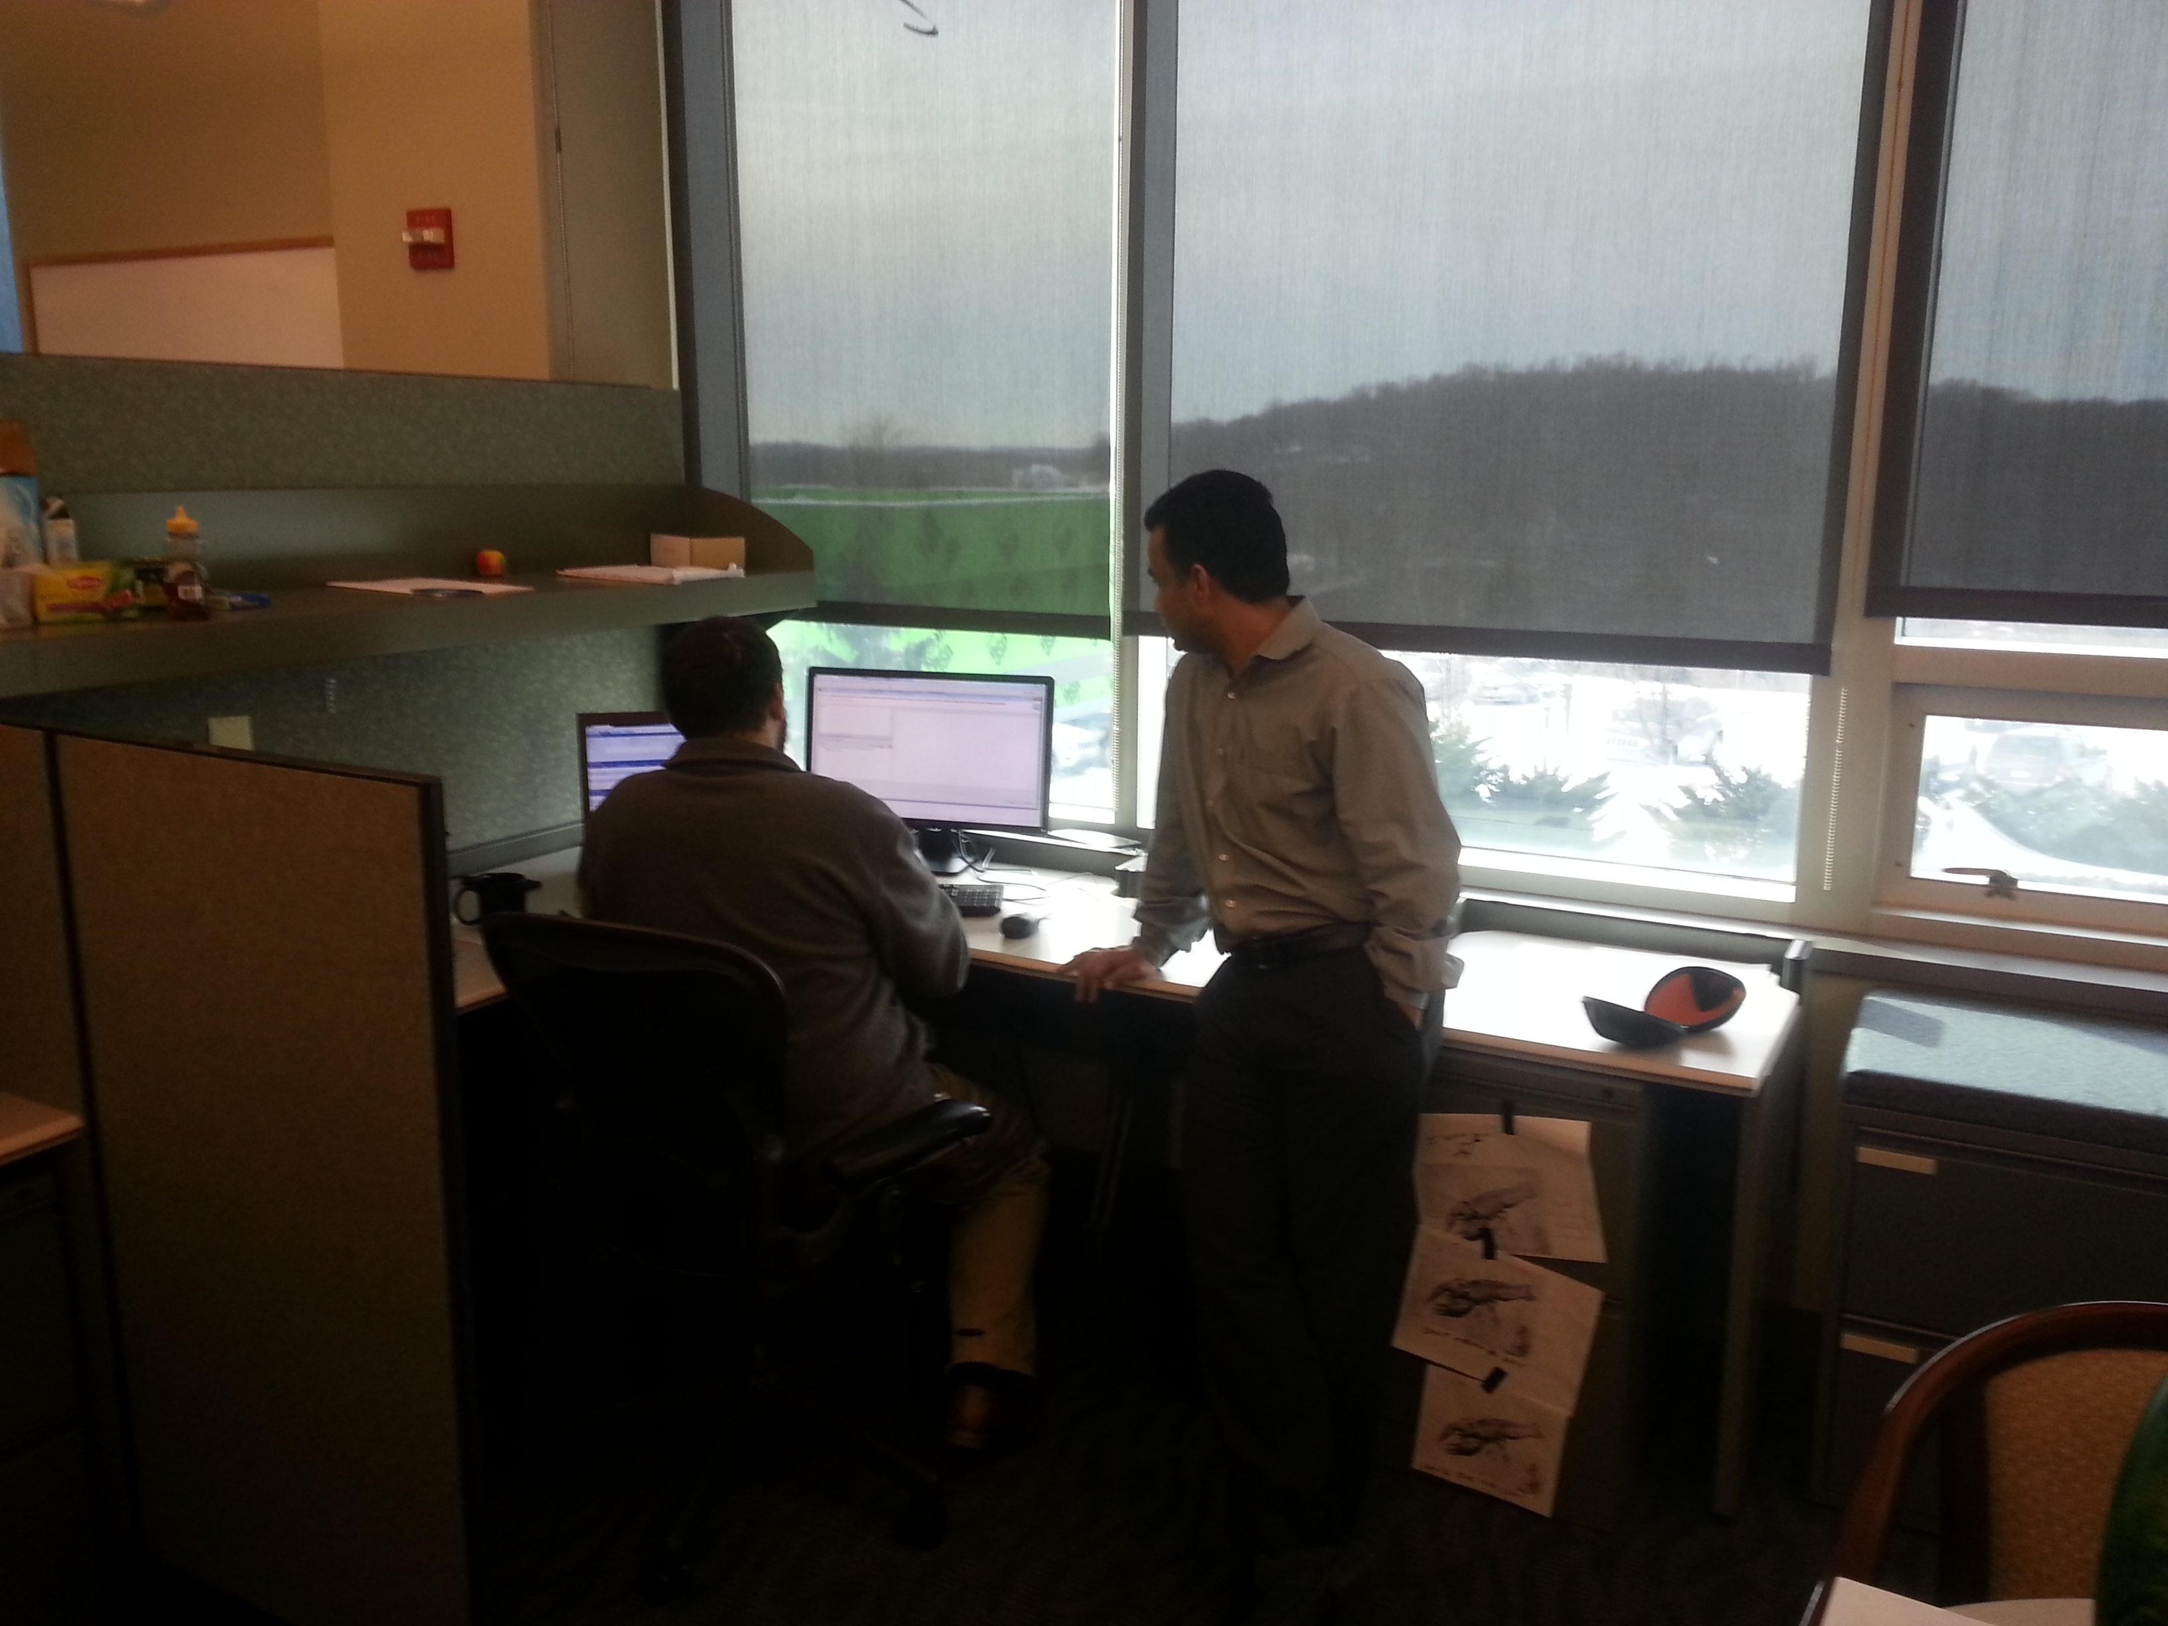
Incremental Design Sessions
Team design session per story
Review acceptance criteria
Time box to 15 – 30 minutes
Focus on unique design hurdles
If not pairing, have primary developer do the homework and present ideas to the team
Notes:
Even if you don’t pair program, get this to be the standard behavior of your team. This will get you the most robust solutions.

Slide 20
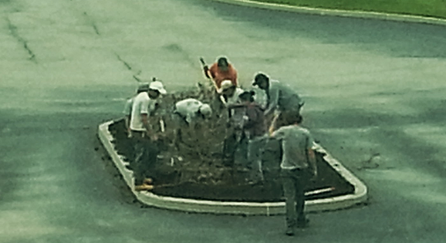
Swarming stories
Two or more per story
Forces communication
Have to agree on how to share code
Notes:
I took this photo last year from my office window. This really captures the concept of swarming. In 15 minutes they had cleared this entire flower bed.
Our typical solution has a UI element and a back end element. We divide that up so they have to coordinate with each other. If there is an emergency, we will swarm the same files forcing extreme collaboration.

Slide 21
Pair Programming Experiment
Divide into two groups
Group A are the mavericks who like to go it alone
Group B are the socialites who like working with others
Goal, to solve 8 logic puzzles, write answers on back of paper
Mark answer with P for Pair or S for Solo
5 Minute time box, one puzzle at a time
Bring current puzzle to owner to get next puzzle (Solved or unsolved)
Notes:
Use a few people to act as coaches
Have the Pairs score the solos and vice versa, keep track of which questions were answered correctly

Slide 22
Answers to Riddles
Keep the first bulb switched on for a few minutes. It gets warm, right? So all you have to do then is ... switch it off, switch another one on, walk into the room with bulbs, touch them and tell which one was switched on as the first one (the warm one) and the others can be easily identified
Pour some water into the pipe so that the ball swims up on the surface. And if you say that you don't have any water, then think about what you drank today and if you can use that somehow :-)
The man is of short stature. He can't reach the upper elevator buttons, but he can ask people to push them for him. He can also push them with his umbrella.
Throw the ball straight up in the air.
You can hang the iron rods on a string and watch which one turns to the north (or hang just one rod).
12:44
He told them to switch camels
The ring is in the silver box
Notes:
Compare number of correct answers by group.
Discussion, Easy answers 4, 6; Moderate questions 2, 5, 8 Hard questions 1, 3, 7

Slide 23
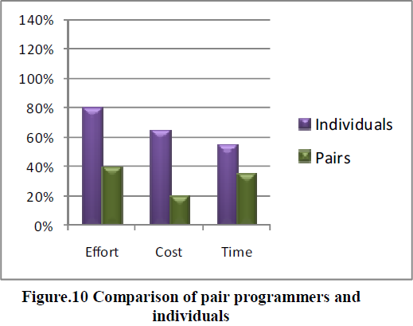
INTERNATIONAL JOURNAL OF ENGINEERING SCIENCES & RESEARCH TECHNOLOGY
Effectiveness of Software Development Process Using Programmer Ranker Algorithm in Pair Programming
Manisha Giri, Saket Soni, Chatrapati Shivaji Institute of Technology, Durg India
2013
Notes:
So this study seems to indicate it is more productive to pair.
Looking at the actual study more closely, this focused on much smaller and simpler artificial solutions, not real world complex solutions

Slide 24
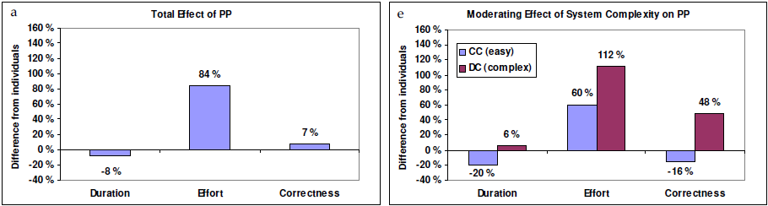
The Effectiveness of Pair Programming: A Meta-Analysis
Jo E. Hannay, Tore Dybå, Erik Arisholm, Dag I.K. Sjøberg
Information and Software Technology(2009), doi: 10.1016/j.infsof.2009.02.001
Notes:
This study looked at other studies of real world projects and organized the results based on complexity of the solution. Significantly different results.
The analysis shows a small significant positive overall effect of pair programming on quality, a medium significant positive overall effect on duration, and a medium significant negative overall effect on effort. However, between-study variance is significant, and there are signs of publication bias among published studies on pair programming. A more detailed examination of the evidence suggests that pair programming is faster than solo programming when programming task complexity is low and yields code solutions of higher quality when task complexity is high. The higher quality for complex tasks comes at a price of considerably greater effort, while the reduced completion time for the simpler tasks comes at a price of noticeably lower quality.

Slide 25
The Costs and Benefits of Pair Programming Abstract
Alistair Cockburn, Laurie Williams University of Utah study
15% increase in Developer costs
15% fewer bugs
Lines of code reduced by 20-25%
“We often came up with different ideas about how the design should go and the result of arguing over which one was better often led to a truly superior hybrid design.”
80-90% of developers enjoyed their work more because of pairing
Notes:
Alistair is one of the signers of the Agile Manifesto but he is not the author of Extreme Programming. He focuses more on behavioral aspects of software development. He did a study with Laurie Williams at the university of Utah and they found these results. This was in the early 2003-4 timeframe.

Slide 26
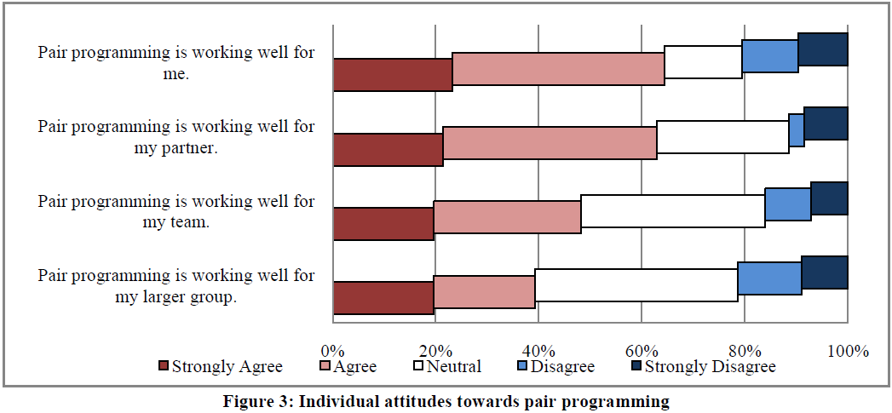
Pair Programming: What’s in it for Me? Microsoft Research, 2008 Andrew Begel, Nachiappan Nagappan
Notes:
Microsoft conducted a survey of practicing pair programmers within their company. Microsoft has given their development teams flexibility in adopting agile. So, these responses will be from both zealots as well as those who had to go along with their team.

Slide 27
Pair Programming: What’s in it for Me? Microsoft Research, 2008 Andrew Begel, Nachiappan Nagappan
Benefits of Pair Programming
Fewer bugs 67%
Higher Code Quality 48%
Spreads Code Understanding 42%
Can Learn From Partner 42%
Better Design 30%
Constant Code Reviews 22%
Two heads are better than one 22%
Better Creativity, Better Testing, Improved Morale
Notes:
This is the results of an open ended question of the benefits This is consistent with one would expect.

Slide 28
Pair Programming: What’s in it for Me? Microsoft Research, 2008 Andrew Begel, Nachiappan Nagappan
Problems with Pair Programming
Cost Efficiency 79%
Scheduling 31%
Personality Clash 25%
Disagreements 24%
Skill differences 22%
Programming style differences 13%
Hard to find a partner 12%
Personal Style, Distractions, Communication, Rewarding Talent
Notes:
Likewise an open survey of the problems
These respondents are only indicating that there is an efficiency impact not that the impact is 79%. It is likely closer to the 15% that Alistair found is his study.
The scheduling clash is only an issue if you don’t have agile teams set up.
Personality clashes are real and so need to be taken into account as you look to do pairing. Good team building techniques are helpful.
Disagreements need to be promoted as good conflict. Teach them how to find the larger objective they both agree on and work back from there.
All of these can be overcome with building a Servant Leader, collaborative culture where teamwork is encouraged and incentivized.

Slide 29
Tips on Pair Programming
Always use with new developers or learning new technology
Try this with your next training program
Always use on complex areas of the system
Take a class on effective pair programming techniques
Driver / Navigator roles
Time boxing and switching roles regularly
Notes:
So, where di you start if you want to start pairing. We probably pair between 10 to 20% of the time. These are the times when we focus on pairing.

Slide 30
Questions?
How well is your team working together?
Are you having effective code reviews?
Are you slicing your stories as thinly as possible?
Are you having mini design sessions with each story?
Are you swarming stories?
Are you pair programming?

